Slide 1
The Open Access Discovery Challenge
Christine Stohn

Slide 2
Agenda
Discovery and open access
Presenting open access in discovery – the theory and the practice
Data examples
NISO ALI
Around and beyond articles ... Some considerations

Slide 3
Discovery and open access
What is open access?
Free for read access?
Free for text mining?
Free for other re-use?
A definition for discovery
An item is freely and openly accessible without requiring authentication by the user
An item has an open access indication in the metadata
An item resides in a known Open Access repository or database or journal collection that we track as being Open Access
https://knowledge.exlibrisgroup.com/Summon/Product_Documentation/Summon%3A_Open_Access_Filter

Slide 4
How should open access material be presented in discovery
Available
Accessible
Flagged as open access

Slide 5
Discovery and open access
Where does Open Access material come from
Publisher feeds
Institutional and other repositories
Aggregates (DOAJ, CORE)

Slide 6
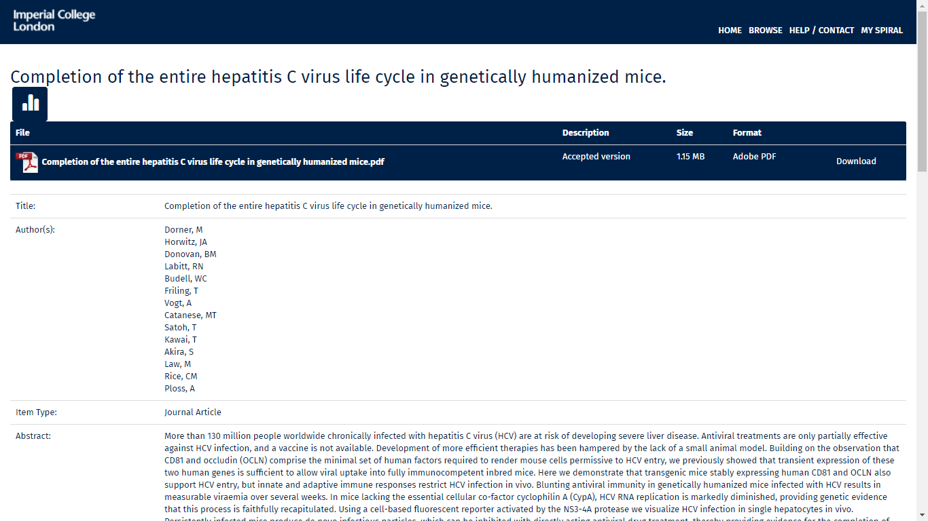
Open access copies from an institutional repository

Slide 7
Challenges with institutional repositories
<oai_dc:dc xsi:schemaLocation="http://www.openarchives.org/OAI/2.0/oai_dc/ http://www.openarchives.org/OAI/2.0/oai_dc.xsd">
<dc:title> …<dc:date>2015-11-20T11:43:52Z</dc:date><dc:date>2015-11-20T11:43:52Z</dc:date><dc:date>2015-11-20</dc:date><dc:type>Thesis or Dissertation</dc:type><dc:type>Masters</dc:type><dc:type>MSc Master of Science</dc:type> …
</oai_dc:dc>
“Please note that access and submission to this collection is only available to authorised users - it is also unfortunately not possible …. to lend Master's theses to individuals or to make them available through Inter-Library Loan”

Slide 8
Open Access indications in provider metadata
<legalStatement type="creativeCommonsBy-nc">
<p>This is an open access article under the terms of the <url href="http://creativecommons.org/licenses/by-nc/4.0/">Creative Commons Attribution‐NonCommercial</url> License, which permits use, distribution and reproduction in any medium, provided the original work is properly cited and is not used for commercial purposes.</p>
</legalStatement>
<articleopenaccess>T</articleopenaccess>
<header><identifier>rug:oai:pure.rug.nl:publications/a837e8b1-eb70-4097-8a40-334fd696aea0</identifier><datestamp>2018-01-30T14:49:46Z</datestamp><setSpec>oa_publication</setSpec><setSpec>openaire</setSpec><setSpec>publication</setSpec></header>
<oa:openAccessInformation><oa:openAccessStatus>http://vtw.elsevier.com/data/voc/oa/OpenAccessStatus#Full</oa:openAccessStatus><oa:openAccessEffective>2016-03-07T00:44:42Z</oa:openAccessEffective><oa:sponsor><oa:sponsorName>Taiwan Society of Anesthesiologists (TSA)</oa:sponsorName><oa:sponsorType>http://vtw.elsevier.com/data/voc/oa/SponsorType#FundingBody</oa:sponsorType></oa:sponsor><oa:userLicense>http://creativecommons.org/licenses/by-nc-nd/4.0/</oa:userLicense></oa:openAccessInformation>
No consistency in flags, analysis source by source
No consistency within one data source
<IsOpenAccess>1</IsOpenAccess>
<license license-type="open-access" xlink:type="simple"> <license-p>This Open Access article is distributed under the terms of the Creative Commons License (<ext-link ext-link-type="uri" xlink:href="http://creativecommons.org/licenses/by/4.0" xlink:type="simple" >http://creativecommons.org/licenses/by/4.0</ext-link>), which permits unrestricted use, distribution, and reproduction in any medium, provided the original work is properly credited.</license-p> </license>

Slide 9
From easy to hard to handle
Good:
Some providers tag all their articles consistently in the same way, regardless whether from OA journal or hybrid

Slide 10
From easy to hard to handle
Easy to handle
<articleopenaccess>T</articleopenaccess>
<IsOpenAccess>1</IsOpenAccess>
<permissions> <copyright-statement>© Eric Toner, 2017; Published by Mary Ann Liebert, Inc.</copyright-statement> <copyright-year>2017</copyright-year> <license license-type="open-access" xlink:type="simple"> <license-p>This Open Access article is distributed under the terms of the Creative Commons License (<ext-link ext-link-type="uri" xlink:href="http://creativecommons.org/licenses/by/4.0" xlink:type="simple" >http://creativecommons.org/licenses/by/4.0</ext-link>), which permits unrestricted use, distribution, and reproduction in any medium, provided the original work is properly credited.</license-p> </license> </permissions>

Slide 11
From easy to hard to handle
Good:
Some providers tag all their articles consistently in the same way, regardless whether from OA journal or hybrid
Harder
Some datafeeds only tag individual oa articles but not articles from full OA journals
Even harder
Collection is flagged as oa as a whole but actually not all items are OA, there other flags to identify the non-OA items

Slide 12
Identifying open access in a data feed
worldbank_openknowledgerepository_oai_openknowledge_worldbank_org_10986_28932
Record 1
<header> <identifier>oai:openknowledge.worldbank.org:10986/28932</identifier> <datestamp>2018-01-16T15:56:27Z</datestamp> <setSpec>com_10986_2123</setSpec> <setSpec>com_10986_4</setSpec> <setSpec>col_10986_2140</setSpec> <setSpec>external_journal_articles_dec</setSpec>
Record 2
<header> <identifier>oai:openknowledge.worldbank.org:10986/29146</identifier> <datestamp>2018-01-12T05:22:41Z</datestamp> <setSpec>com_10986_2210</setSpec> <setSpec>col_10986_4401</setSpec> <setSpec>external_journal_articles_dec</setSpec>
Solution:
Set rule to exclude all with <setSpec>col_10986_4401</setSpec>

Slide 13
Flagging embargoes
<dc:rights>Copyright © 2017, Rights Managed by Nature Publishing Group</dc:rights>
<dc:rights>2018-05-01</dc:rights>
<dc:publisher>Nature Publishing Group</dc:publisher>
<dc:rights>This is a pre-copyedited, author-produced PDF of an article accepted for publication in British Journal of Anaesthesia following peer review. The version of record BJA: British Journal of Anaesthesia, Volume 119, Issue suppl_1, 1 December 2017, Pages i72–i84, https://doi.org/10.1093/bja/aex383 is available online at: https://dx.doi.org/10.1093/bja/aex383</dc:rights>
<dc:rights>2018-11-17</dc:rights>
<dc:publisher>Oxford University Press (OUP)</dc:publisher>
<dc:relation>Nature</dc:relation>
<dc:rights>© 2016 Macmillan Publishers Limited, part of Springer Nature. All rights reserved.</dc:rights>
<dc:publisher>Nature</dc:publisher>
<dc:rights>This article may not exactly replicate the final version published in the APA journal. It is not the copy of record. This article is under embargo until publication</dc:rights>
<dc:rights>10000-01-01</dc:rights
><dc:publisher>APA</dc:publisher>

Slide 14
From easy to hard to handle
Good:
Some providers tag all their articles consistently in the same way, regardless whether from OA journal or hybrid
Harder
Some datafeeds only tag individual oa articles but not articles from full OA journals
Even harder
Collection is flagged as oa as a whole but actually not all items are OA, there other flags to identify the non-OA items
(almost) Impossible
All items in a collection are flagged as open access or collection is open access but there are exceptions – without a way to identify them

Slide 15
Coming back to the challenge
Analysis and ingest source by source is very time consuming
Use of standardized (and simple) formats will enable better and faster ingest into discovery indexes

Slide 16
NISO ALI - http://www.niso.org/schemas/ali/1.0
Purpose
to standardize bibliographic metadata to describe the accessibility of journal articles
communicate the item's license details
Core part of the recommendations
free_to_read tag
Optional: a start date to define the time point when the work will become free-to-read and/or an end date when it will cease to be free-to-read
license_reference tag
A reference to a URI that carries the license terms (e.g. re-use rights)

Slide 17
Examples for NISO ALI implementations
<document>
...
<free_to_read xmlns="http://www.niso.org/schemas/ali/1.0/" start_date="2014-01-01"
end_date="2014-12-31"/>
<license_ref xmlns="http://www.niso.org/schemas/ali/1.0/" start_date="2015-02-03">
http://www.examplesite.org/open_license.html
</license_ref>
...
</document>
Source: http://www.niso.org/schemas/ali/1.0

Slide 18
Examples for NISO ALI implementations
JATS (Journal Article Tag Suite) – application of NISO Z39.96-2015
...
<permissions>
<ali:free_to_read xmlns:ali="http://www.niso.org/schemas/ali/1.0/"
start_date="2014-01-01" end_date="2014-12-31"/>
</permissions>
...
Source: https://jats.nlm.nih.gov/archiving/tag-library/1.1/element/ali-free_to_read.html

Slide 19
Coming back to the challenge
Analysis and ingest source by source is very time consuming
Use of standardized (and simple) formats will enable better and faster ingest into discovery indexes

Slide 20
Around and beyond articles ...
How do we treat different versions of the same article?

Slide 21
Different versions of an article: pre-copyedited and embargoed
From the metadata:
<dc:rights>This is a pre-copyedited, author-produced PDF of an article accepted for publication in British Journal of Anaesthesia following peer review. The version of record BJA: British Journal of Anaesthesia, Volume 119, Issue suppl_1, 1 December 2017, Pages i72–i84, https://doi.org/10.1093/bja/aex383 is available online at: https://dx.doi.org/10.1093/bja/aex383</dc:rights>
<dc:rights>2018-11-17</dc:rights>

Slide 22
Different versions of an article: Submitted and under consideration

Slide 23
Around and beyond articles ...
How do we treat different versions of the same article?
Should articles from „predatory“ open access journals be made discoverable and who defines what predatory means?
What do you think about Open Educational Resources (OER)? Open Textbooks?
What is a „good“ resource and who sets that „standard“?
In what context is a resource „good“ and „useful“?

Slide 24
Thank You

