Slide 1


Slide 2
Interaction Analysis
Evaluating Journal Agreements
By Jens H. Aasheim
/License Agreements & Open Access (LÅT)
/Sikt - Norwegian Agency for Shared Services in Education and Research

Slide 3
What to expect from this presentation:
Background
Method
Example Analysis

Slide 4
Interaction Analysis - Background
Access
Relevance
Visibility
How much of the content paid for through the agreement is actually accessed? And how does the cost of the agreement compare to the estimated cost of accessing this content without an agreement?
How significant or influential is the content? For instance, how often do authors from an institution cite content provided through the agreement? Such as references (outgoing citations) made in a member institution’s total research article output, regardless of journal, to any article published in a specific journal covered by the agreement.
What is the importance of publishing in these journals and what is the publishing potential? For instance, how often authors from a member institution publish articles in agreement journals. And how does the APC cost compare to a potential agreement publishing cost?

Slide 5
Interaction Analysis - Method
Estimating the value and importance of an agreement from the perspective of our member institutions. Based on the institution's interactions with each journal.
Performed on a per institution and per journal basis.
Evaluate the relationship between a journal and an institution
Repeat for all journals to form an institution-agreement analysis
Aggregate institution analyses to consortium level analysis

Slide 6

Interaction Analysis - Method
Each journal is classified as relevant or not, for a specific institution. A relevant journal is considered important and with a relative value high enough to justify a subscription. This evaluation is based on a theoretical value rate called IA Cost Factor(IACF).
Calculated from the cost of a single institutional subscription vs a weighted total of interactions.
The interaction types are individually weighted by importance, influence and their respective contribution to the overall relevance of the journal.

Slide 7
Interaction Analysis - Interactions
COUNTER Downloads
ILL Cost (single access)
A coarse estimation of ILL requests is calculated from downloads and a conversion factor. Only non-free downloads are counted, OA and PCA content is excluded. The conversion factor is based on literature, local empirical data and previous experience.
The ILL cost is also factored into the calculation. This is a combination of the actual ILL cost plus an estimated overhead, covering additional administration costs.
References
Corresponding Publications
To complement and adjust the approximate value of the COUNTER downloads, the weighted number of journal references is added to the calculation.
Another essential contribution to evaluating the importance of a journal is the weighted number of published corresponding articles.

Slide 8
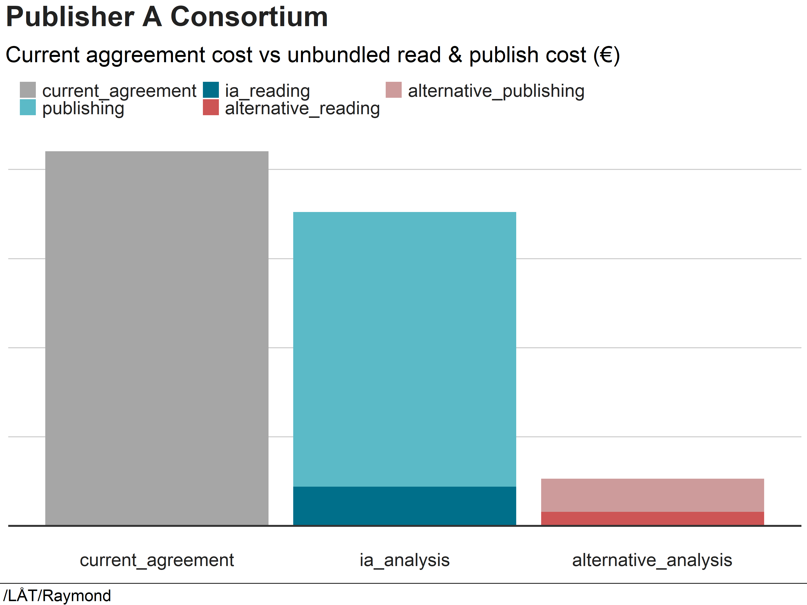
Interaction Analysis - Example
publisher | A
participant | consortium
journals_total | 1 348
relevant_journals | 260
articles_pub_reports | 714
articles_1st_corr | 892
journals_no_interaction | 226
journals_with_downloads | 1 122
journals_with_pub_rep | 257
journals_with_1st_corr_pub | 268
journals_referenced | 981
journals_transformative | 32

Slide 9
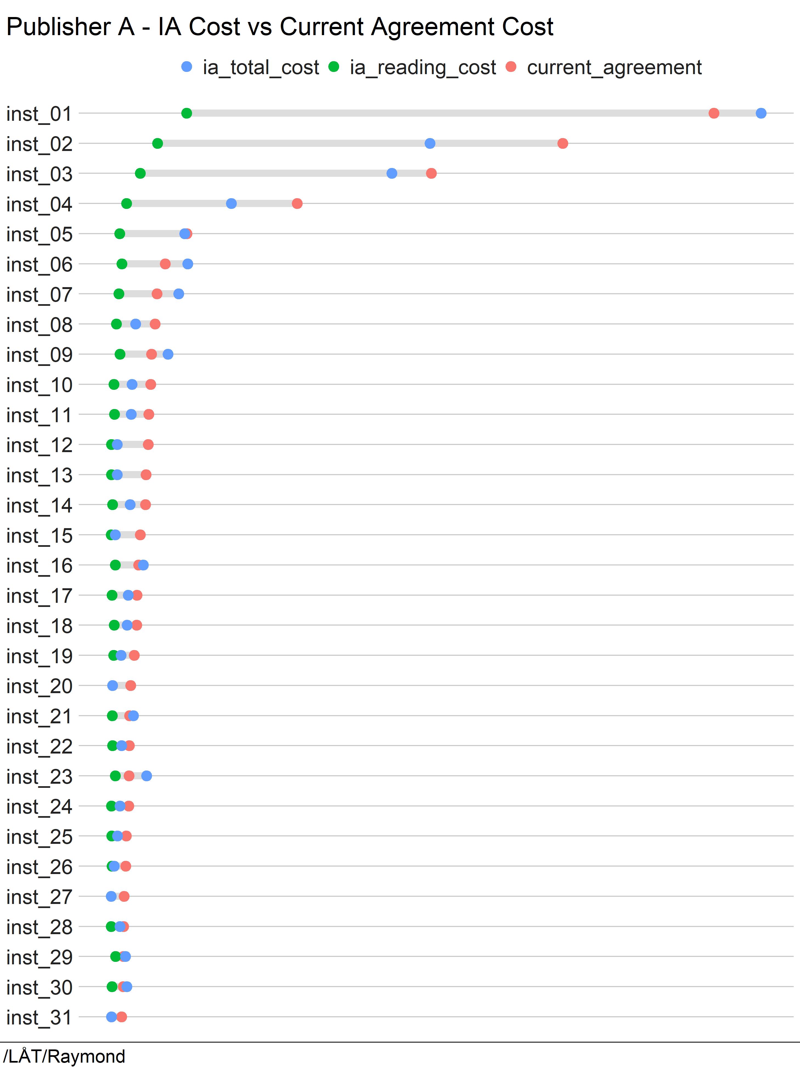
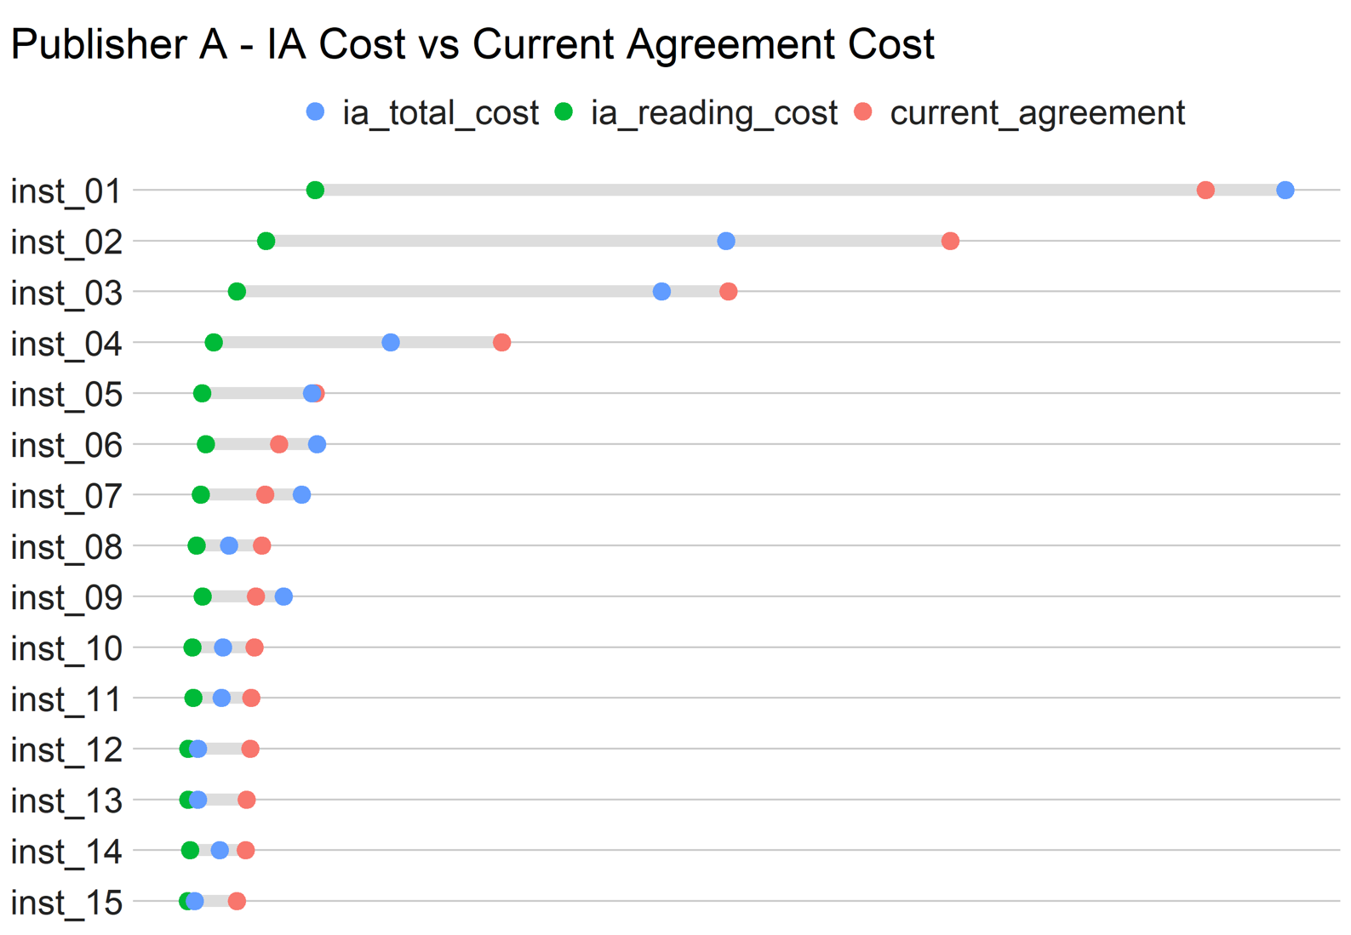

Estimated reading cost
Publishing + reading cost
Current cost

Slide 10



Thank you
Jens H. Aasheim
/Sikt/License Agreements & Open Access
Email: jens.aasheim@sikt.no
github.com/
openscience-no

