Slide 1


Expanding Open Access availability with article-level intelligence
Jonathan Bunkell
VP Sales
Third Iron, LLC
jonathan.bunkell@thirdiron.com

Slide 2






35
countries
99%
renewed
1,600+
libraries

Slide 3

Third Iron Customers in Denmark
University of Southern Denmark
Odense University Hospital
University College Copenhagen
University College of Northern Denmark
University College Absalon
VIA University College
Copenhagen Business School

Slide 4



Article Metadata
Library Entitlements
OA VoR
Enhanced Open Access Availability
Subscribed Journal Publisher
Library Authentication
Subscribed Journal Aggregator
Article Version
Non-VoR OA
Available Article Formats
Aggregator Availability
ILL/Document Delivery
Editorial Status
Article Intelligence Data
AI-based source selection
Full text
Article Record

Slide 5














Discovery
services
Databases
LibKey
Full Text
Open Web
Searching

Slide 6

Need for accurate OA data
Growing publication of Open Access articles requires accurate understanding of availability and reliable article links

Slide 7

State of OA linking today
Different sources of Open Access information, using different methodologies
Varying abilities and speed in correcting errors
Results for linking
Missing Open Access articles
Incorrect links
Misidentifying articles as Open Access
Incomplete links to available formats
Unclear versioning
OA knowledge

Slide 8




Need for library centric-OA linking
Blending of Open Access data sources
Operational control
Stay current

Slide 9


Hybrid example
Hybrid journal: a subscription journal in which only some articles are Open Access

Slide 10
Hybrid journals indexed in databases
A majority of the articles indexed by databases like PsycINFO, Web of Science, and EBSCO Academic Search are from hybrid journals

Slide 11



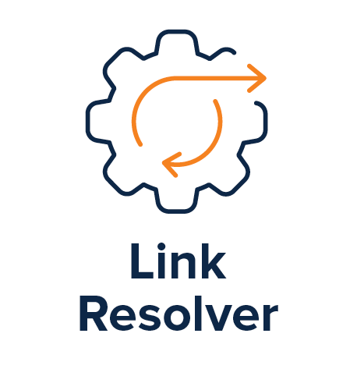
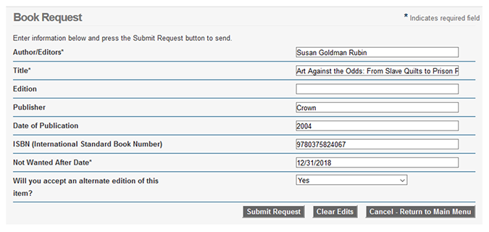




Hybrid journals
Interlibrary Loan
Unnecessary ILL requests
Delays in access
Frustrated users
Indexed In Databases
Results
OA Articles

Slide 12
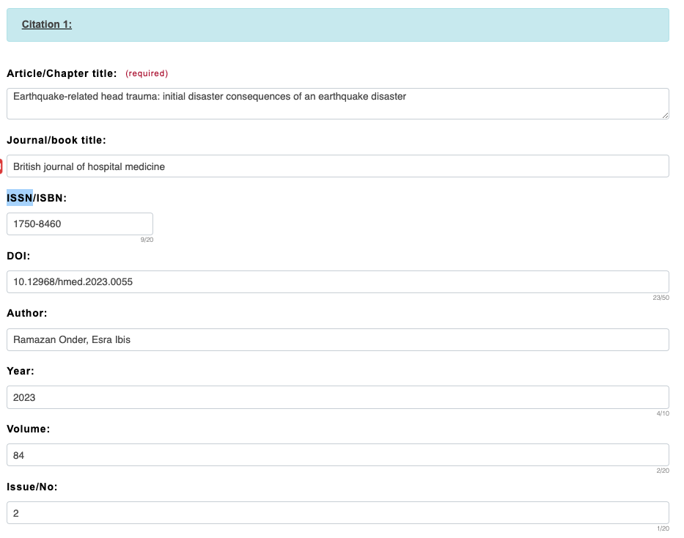

Current experience
Since the journal is not subscribed, the link resolver will point to ILL
Creates delay in access and unnecessary ILL requests

Slide 13

LibKey experience
Article request is first processed by LibKey
LibKey recognizes the article as OA
User gets immediately to full text
Article-level intelligence, AI-based source selection

Slide 14
Tak!
Jonathan Bunkell
VP Sales
Third Iron, LLC
jonathan.bunkell@thirdiron.com

